Slide 1
Crime Incidents in Los Angeles
By: Kassidy Ackerman, Daniel DeLuca, Zachary Broomall, Casey Campbell

Slide 2

Project Motivation and Background
Crime data analysis
Allows us to understand and predict why and how crimes are occurring which leads to coming up with solutions of how to prevent and lower those crime rates
Crime prevention
Suspect apprehension
Increase order in society
Asses agency protocols and strategies

Slide 3
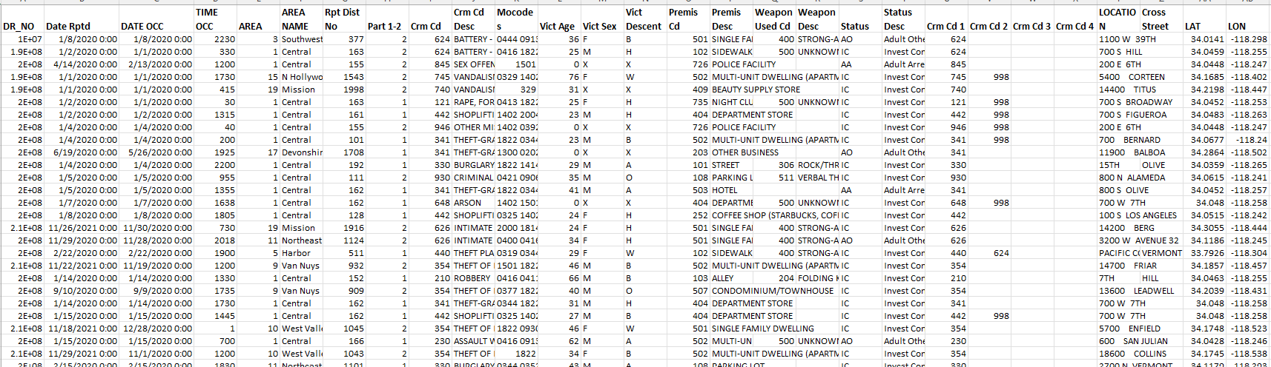
Data Preparation
First, we obtained the crime data from a government data catalog. In regard to cleaning the data, we did not change any column names as we felt as if the current names were in the best format. The columns are short, clear, and understandable. The data set contained some blank rows, but after assessing the data itself we decided to not make any adjustments to the data formatting as we felt the data is in good condition for analysis.

Slide 4
Data Description
DR_NO: primary key
Date Rptd: date that the crime was reported
Date Occ: date that the crime occurred
Time Occ: time that the crime occurred
Area: area in numeric code
Area Name: area name
Rpt Dist No: reported district number
Part 1-2: part 1 crime or part 2 crime
Crm Cd: crime code
Crm Cd Desc: crime code description
Mocodes: MoCodes
Vict Age: victim age
Vict Sex: victim sex
Vict Descent: victim descent
Premis Cd: premis code
Premis Desc: premis description
Weapon Used Cd: weapon used code
Weapon Desc: weapon description
Status: status code
Status Desc: status description
Crm Cd 1: crime code 1
Crm Cd 2: crime code 2 (for multiple offenses)
Crm Cd 3: crime code 3 (for multiple offenses)
Crm Cd 4: crime code 4 (for multiple offenses)
Location: Address
Cross Street: cross street
Lat: latitude
Lon: longitude

Slide 5
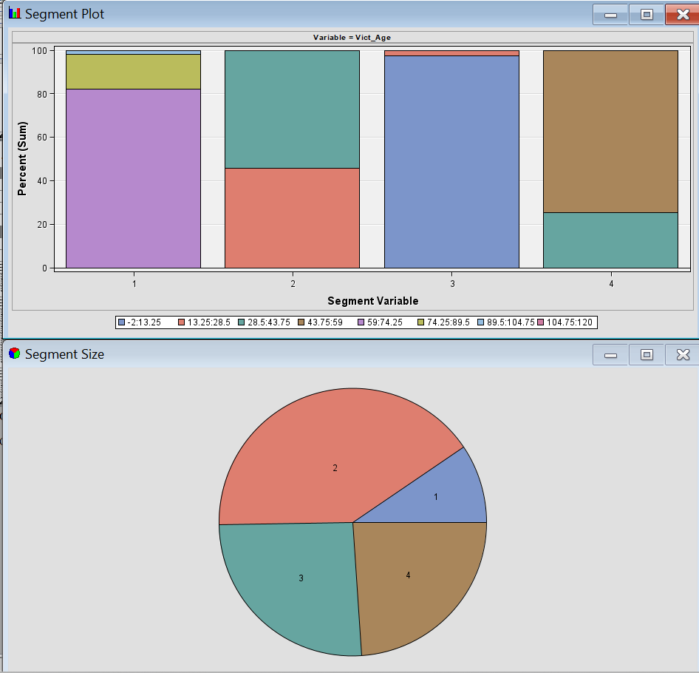
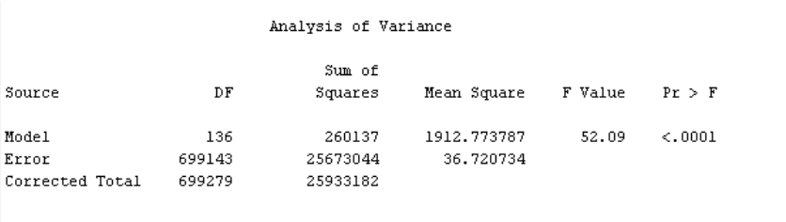
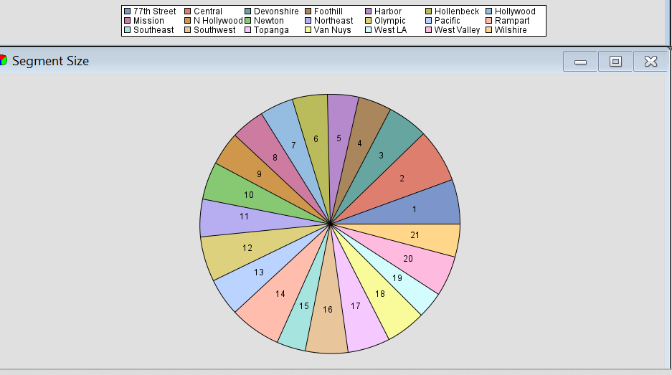
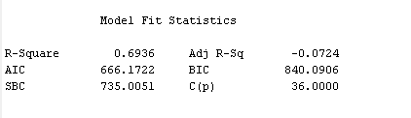
SAS Models and Diagrams
Diagram 1
Cluster Diagram of Regions
Diagram 2
Cluster Diagram of Victim age
Diagram 3
Regression
Notes:
The regression was run with time occured as the target variable and the input variables as listed: area, crime code, crime code 1, crime code 2, crime code 3, crime code 4, part 1 or 2, premis code, premis description, reported district number, status, victim age, victim descent, victim sex, and weapon used code. The p-value is statistically significant and the r-squared value is moderately high which signifies this model explains a good portion of the variability.

Slide 6
Findings Diagram 1
This cluster shows the frequency of crime in each region of the data.
Highest frequency of crime occurs in the “Central” region (Cluster 2) having 46803 instances
Second highest cluster (Cluster 14) “77th Street”.
lowest cluster is “Foothill” (Cluster 19) at 23705 instances.

Slide 7
Findings Diagram 2
Shows the age distribution of the victims to the crimes.
largest number of victims of crimes are between the ages of 13 and 44 (Cluster 2).
age range of 59 to 105 (Cluster 1) has the least amount of crime committed against them

Slide 8
Findings Diagram 3
Target variable: time that the crime occurred
P-value < 0.0001
Statistically significant
R-square of 0.6936
Moderately high
The model is an overall good fit and explains a good portion of the variation within the data and is significant

Slide 9
Conclusion
Crime data allows law enforcement to prevent crimes, apprehend suspects and known criminals, reduce disorder, and to assess strategies and their courses of action.
Time of day with high crime rates means there should be more law enforcement officials on duty for crime prevention
More balanced resource allocation based on regions with higher frequencies of crime
Central location
Preventative measures when considering the age groups of potential victims
Allocate more attention to individuals who are in a more vulnerable age group
Ages 13-44

